Slide 1

Docker
Presented By Sudip Kumar

Slide 2
My Introduction
My name is Sudip Kumar and I have Total 13+ Year of IT experience. I have been worked in different organizations where I worked for Teir1 Clients like (Walmart, AT&T and Wellsfargo etc ). I have been worked in multiple Domains like Telecom, Baking & Finance, Health, Retail etc.
I am currently working as a Cloud & Devops Architect where i am providing the solution to the client on Cloud and Devops Area. I have total 2 + Years of experience in Docker and Kubernetes Technology. I have been worked on Migration project where i provided the solution to client to move their traditional monolith application to container base application.
I will be your instructor where I will take you through Docker technology and we will learn how we can build and deploy container.

Slide 3
Agenda
Hypervisor based Virtualization
Virtualization Vs Containerization
Docker Introduction
Container vs Image
Docker Hub
Docker Compose

Slide 4
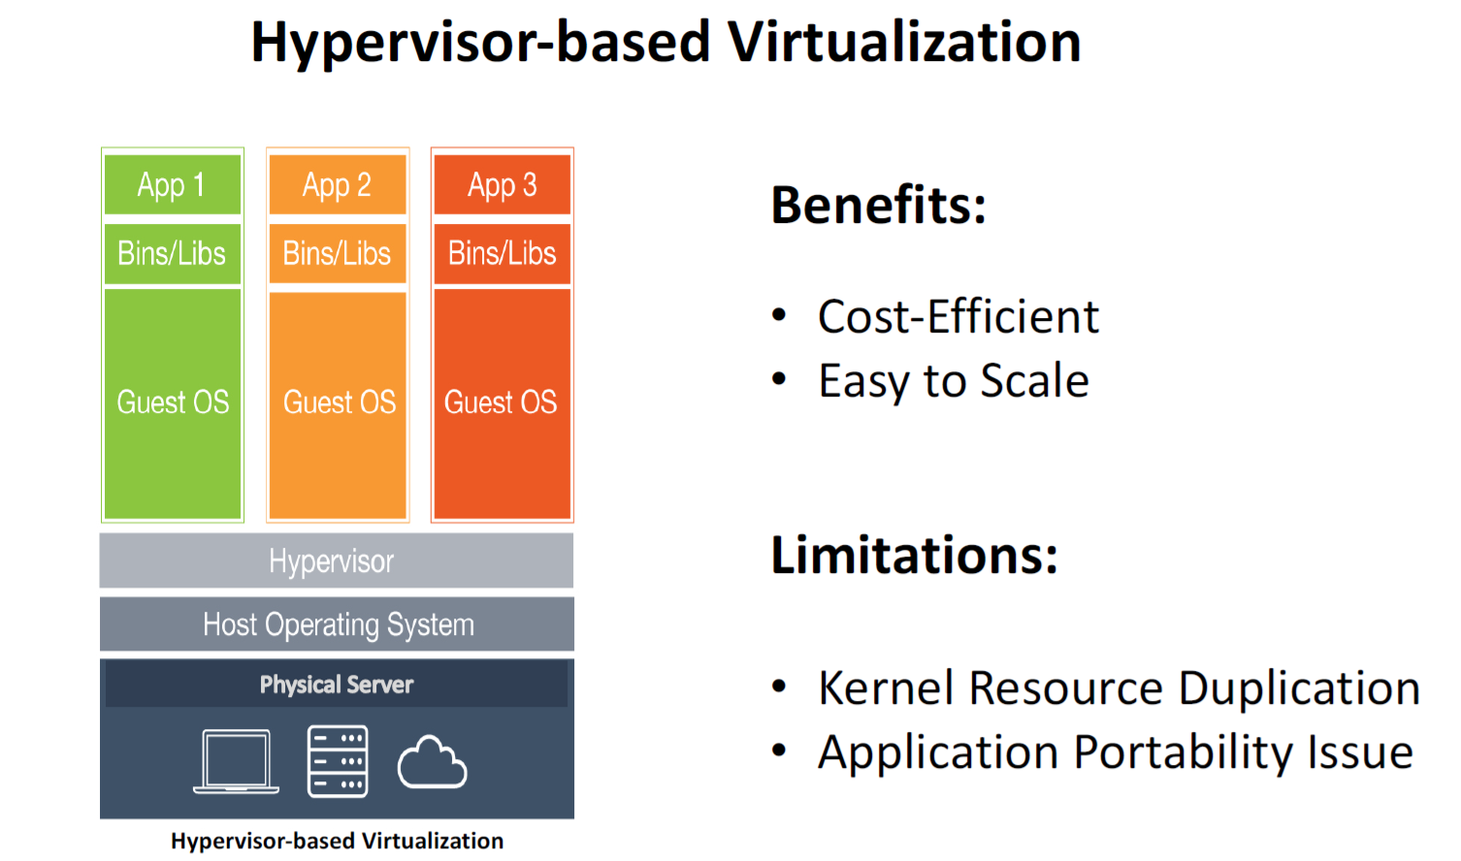
Hypervisor Based Virtualization

Slide 5
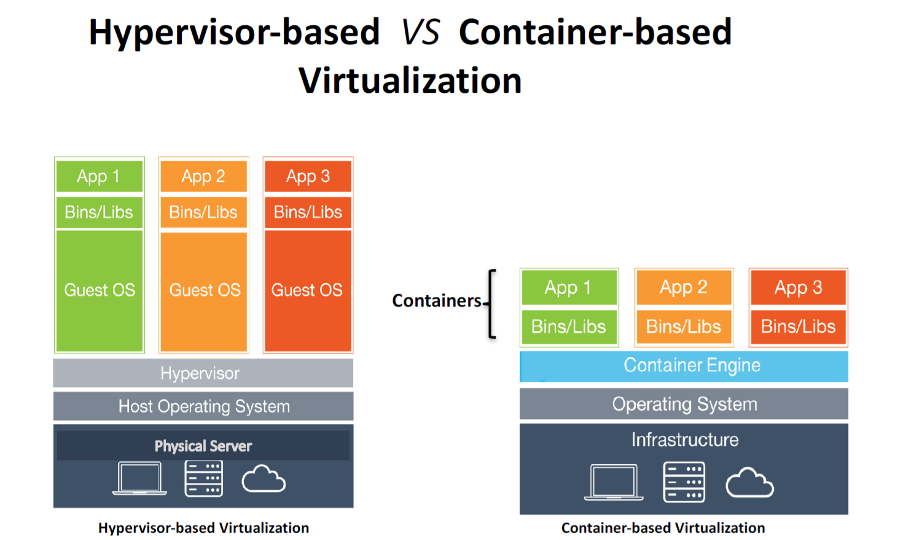
Virtualization Vs Containerization

Slide 6
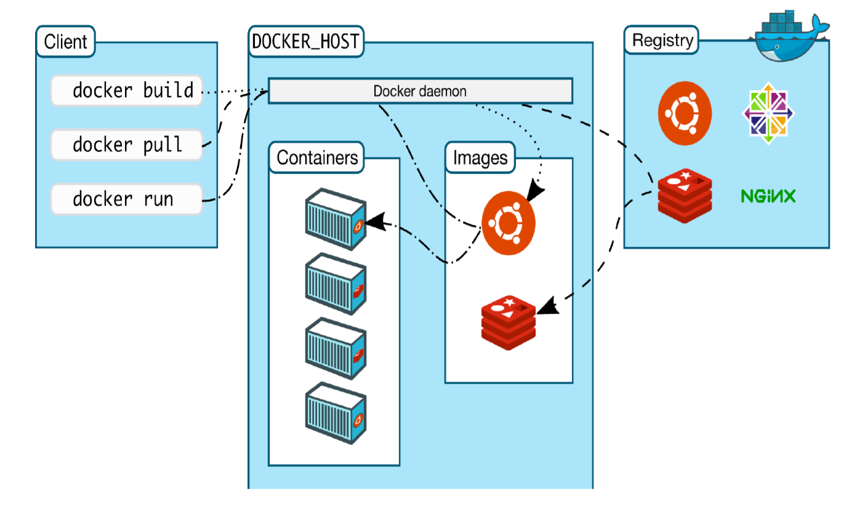
Docker Introduction
Docker Engine is an open source containerization technology for building and containerizing your applications. Docker Engine acts as a client-server application with:
A server with a long-running daemon process dockerd.
APIs which specify interfaces that programs can use to talk to and instruct the Docker daemon.
A command line interface (CLI) client docker.

Slide 7
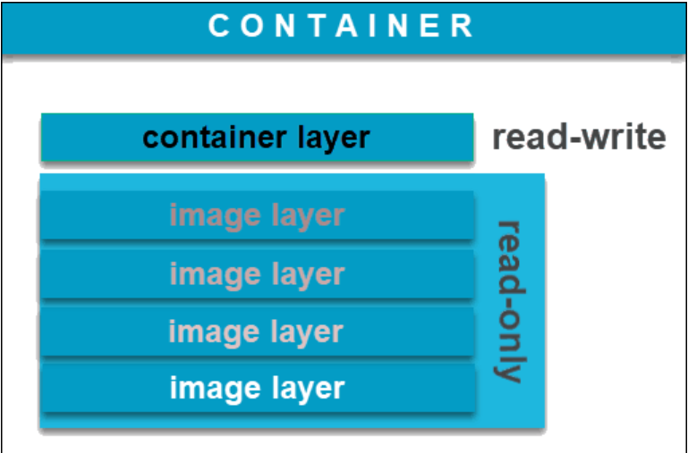
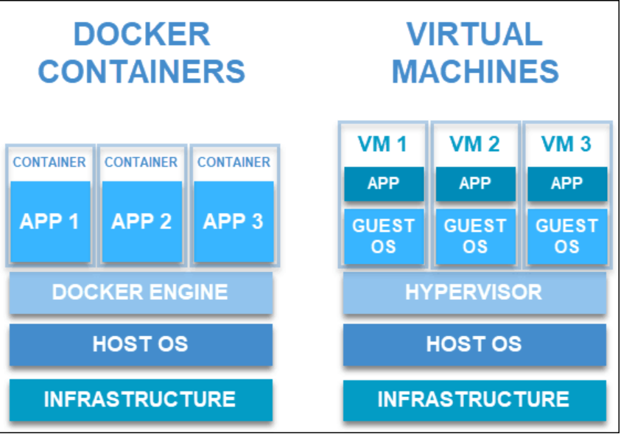
Container vs Image
A Docker image is an immutable (unchangeable) file that contains the source code, libraries, dependencies, tools, and other files needed for an application to run.
A Docker container is a virtualized run-time environment where users can isolate applications from the underlying system.

Slide 8
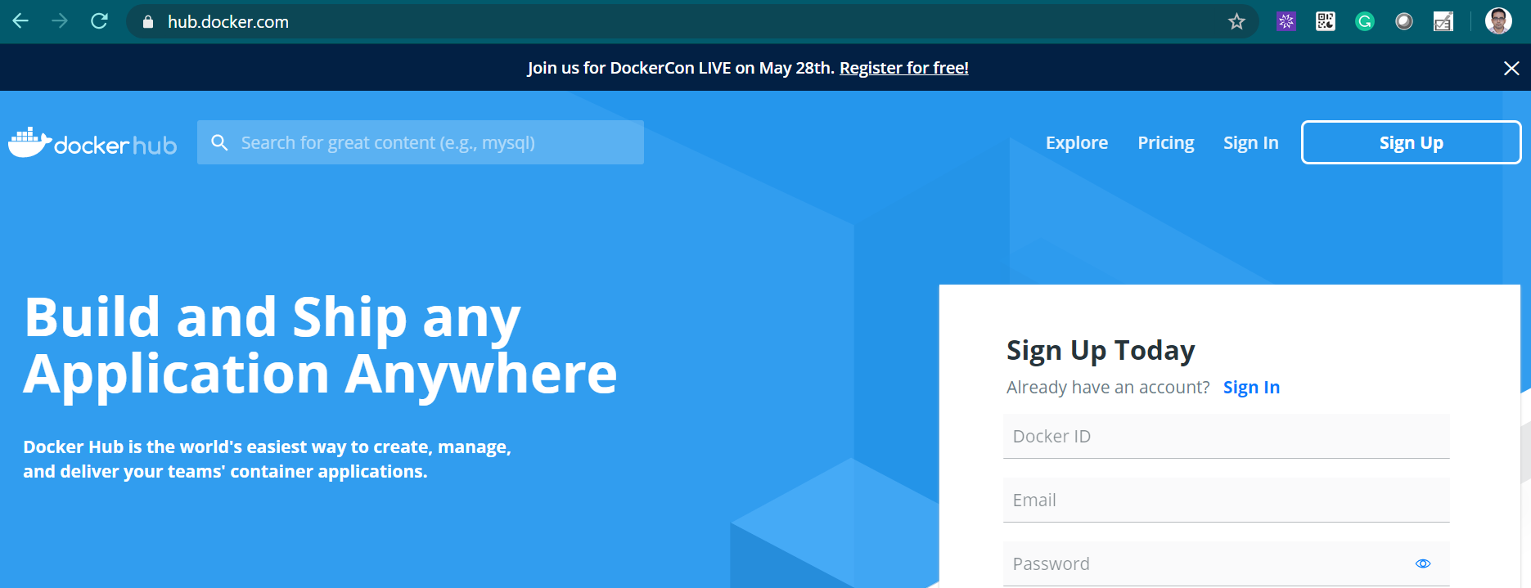
Docker Hub
Docker Hub is a service provided by Docker for finding and sharing container images with your team.

Slide 9
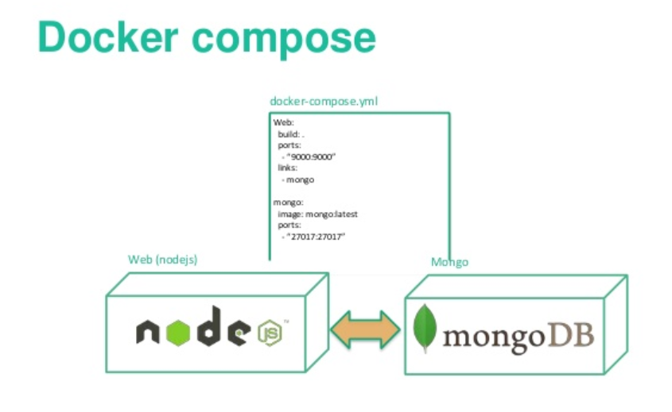
Docker Compose
Compose is a tool for defining and running multi-container Docker applications With Compose, you use a YAML file to configure your application’s services. Then, with a single command, you create and start all the services from your configuration

Slide 10
Thank YOU

